Slide 1
Bits & Bots

Slide 2
Bits & Bots Sessions
Session | Topic
Tuesday 20th May, 6 – 8pm | Intro to 3D Design: Design custom robot parts to print on the 3D printers
Tuesday 27th May, 6 – 8pm | Intro to Electronics: Learn how the electronic parts in the kit work, design our robot circuits
Tuesday 3rd Jun,e 6 – 8 pm | Intro to Arduino: Write NodeJS programs to read from sensors and control actuators
7th June, 1 – 5 pm | Intermediate 3D Design: Design more complex robot parts: gears, claws etc
14th June, 1 – 5 pm | Intermediate Arduino: Develop our robots' locomotion, sensing and responding behaviours
21st June, 1 – 6 pm | Advanced Bits & Bots: Finalise robot design and assembly, develop advanced robot control programs

Slide 3
Bits & Bots Slides etc
Slides and other materials for the course will be published after each session here:
https://github.com/AnnaGerber/bits-n-bots

Slide 4
Chassis
Sensors
(Inputs e.g. ultrasonic sensor)
Power
Control
(Microcontroller = brain)
Actuators
(Outputs e.g. motors)

Slide 5
Physical Computing
Building interactive systems that sense and act on (or respond to) the physical world

Slide 6
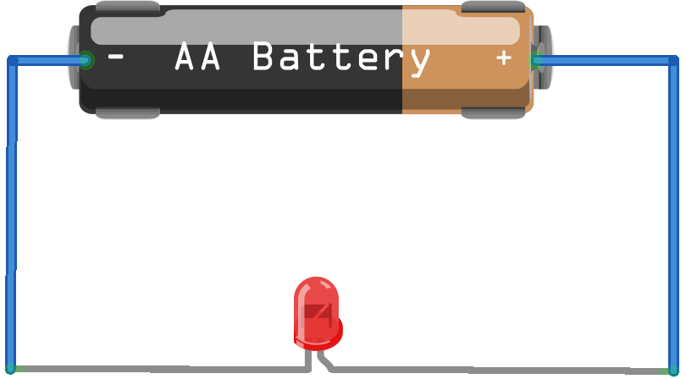
Electricity
Electricity is a form of energy
We can connect components that convert electrical energy into other forms of energy: light, sound, movement, heat etc, into a circuit
In a Direct Current (DC) circuit,
electrical energy flows from
the positive side of a
power source to the
negative side, i.e. from
+ (power) to – (ground)

Slide 7
Electrical concepts
Current (Amps): measures the flow of electrical energy through a circuit
Voltage (Volts): measures difference in potential energy between the positive and negative sides of a circuit
Resistance (Ohms): measures a material's opposition to the flow of energy
Power (Watts): the rate at which energy is converted from one form to another

Slide 8
Ohm's Law
Current = Voltage / Resistance
Increase the voltage, and the current will increase (i.e. speed up)
Increase the resistance and the current will decrease

Slide 9
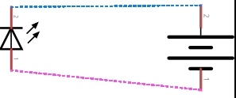
Circuit Schematics
Diagrammatic representations of components and how they are connected

Slide 10
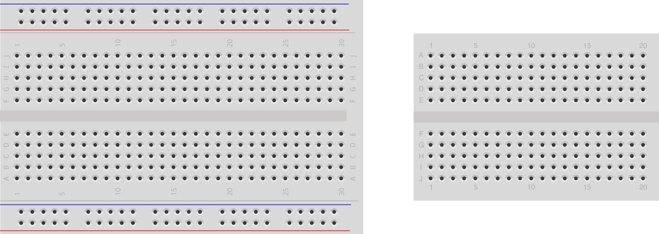
Using a Breadboard
Use to prototype circuits without soldering by plugging in components and jumper wires
Numbered rows are connected
Some have power rails along the sides

Slide 11
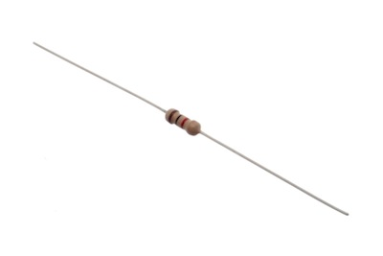
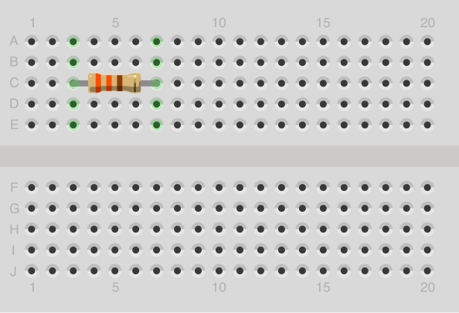
Resistors
Introduces resistance, so restricts the amount of current that can flow through a circuit
Can be connected in either direction
Bend and trim the leads to approx 1cm each make it easier to use with the breadboard

Slide 12
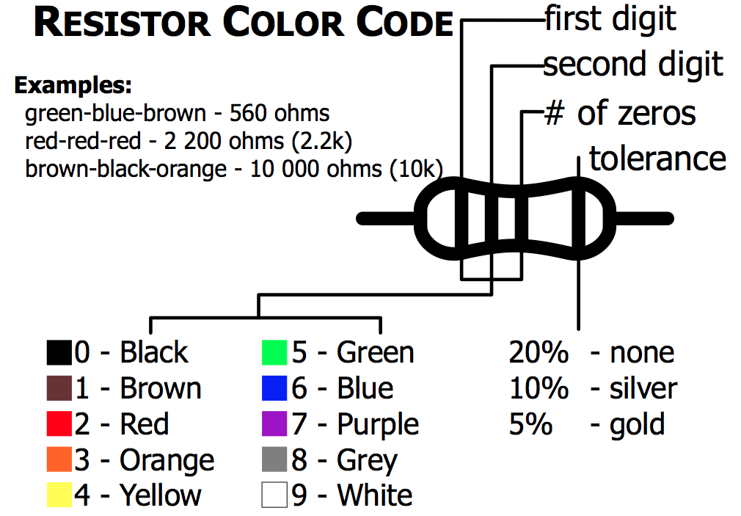

Slide 13

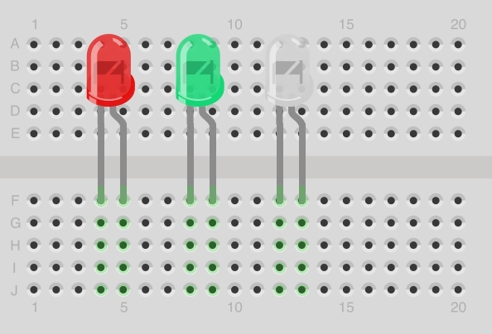
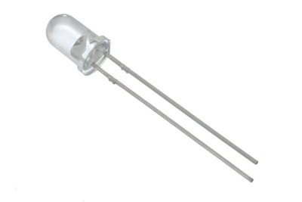
LEDs
Light Emitting Diode
Polarized: diodes act like one way valves so must be connected in a certain direction
Emits light when a current passes through
Cathode (-)
connects to ground
Anode (+)
longer lead
connects to power

Slide 14
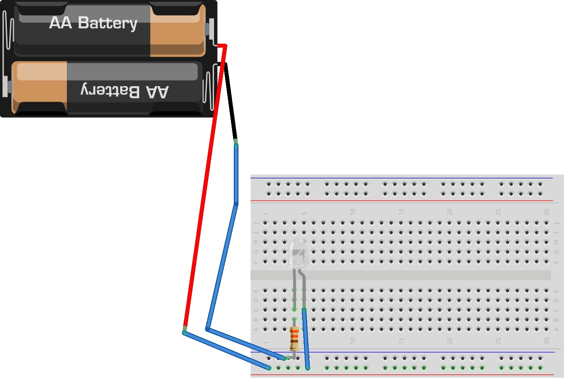
Creating a circuit
Hook up an LED to a power source: anode to + and cathode to -
Include a current limiting resistor to avoid damaging the LED

Slide 15
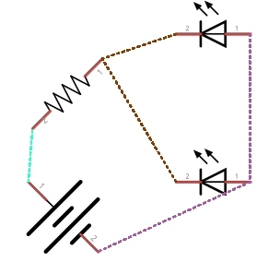
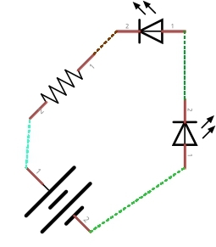
Adding more components
Add a second LED to your circuit, experiment with connecting the LEDs in parallel vs series

Slide 16

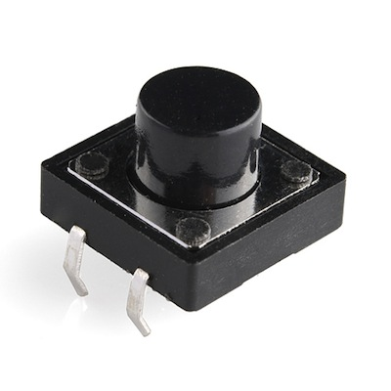
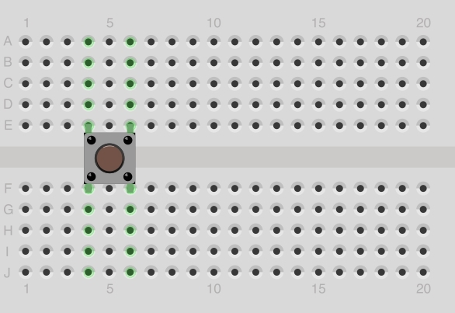
Pushbuttons
Also known as a momentary switch
Can be connected in either direction
Has two sets of leads on either side
Use leads from the same side together

Slide 17
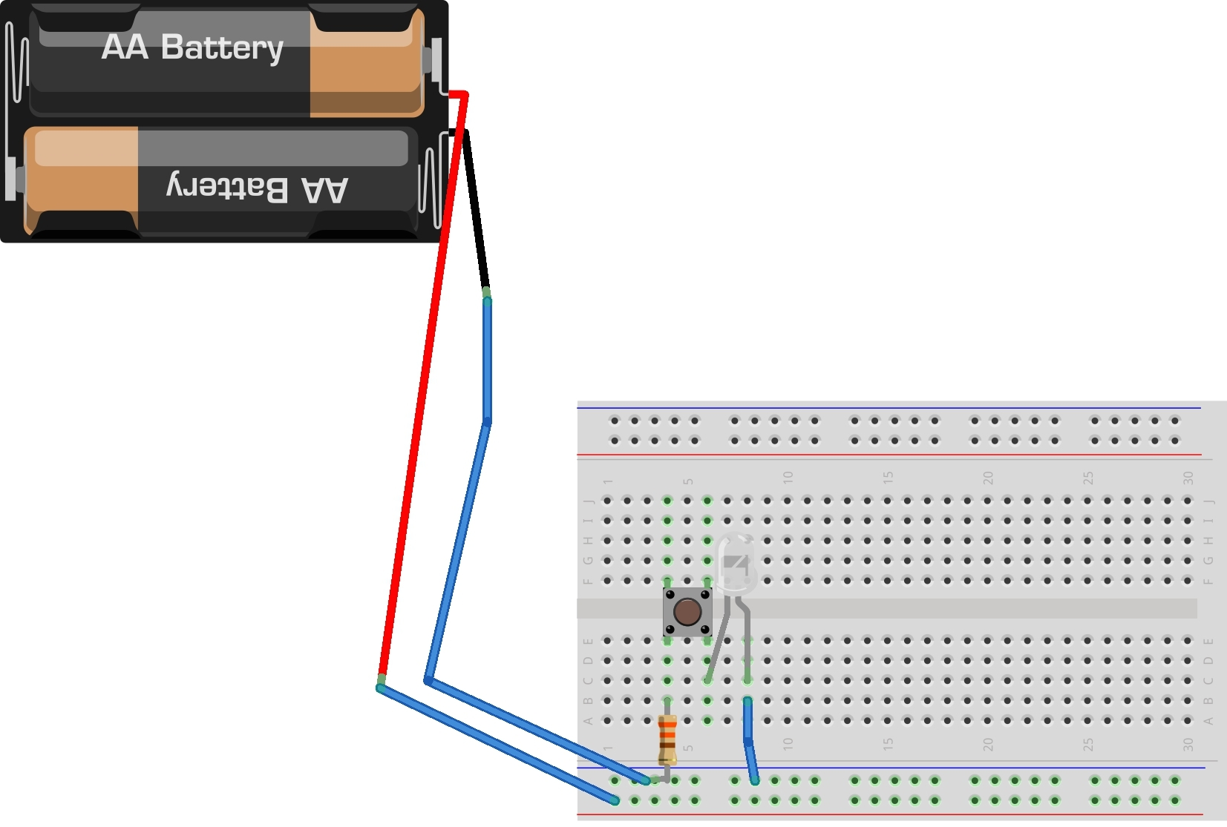
Add a button to your circuit

Slide 18
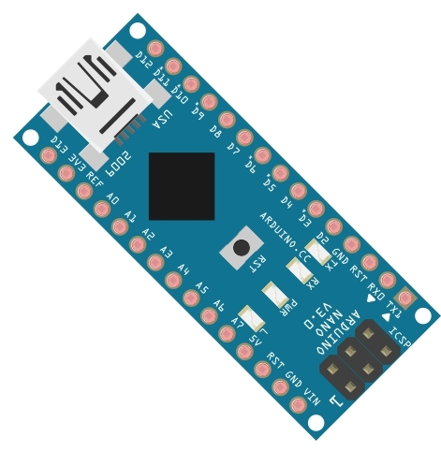
Control
Microcontroller co-ordinates robot inputs (sensors) and outputs (actuators)
We are using an Arduino Nano clone
See http://arduino.cc/

Slide 19
Sensors
Environmental conditions (e.g. temperature, humidity, smoke)
Magnetic (e.g. hall effect sensor)
Light (e.g. photo resistor)
Sound (e.g. microphone)
Motion (e.g. accelerometer, tilt, pressure)
User / Physical Input (e.g. button)

Slide 20
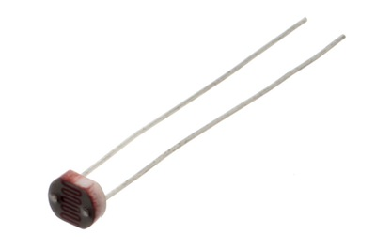
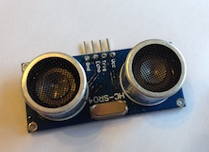
Sensors in our kits
 | PHOTO RESISTOR Produces a variable resistance dependant on the amount of incident light.
 | Ultrasonic Sensor Used to detect distance from objects.
 | PUSHBUTTON Can be used as a bump sensor: indicates that the robot has bumped into something when pressed

Slide 21
Actuators
Light & Displays (e.g. LED, LCD)
Sound (e.g. Piezo buzzer)
Motion (e.g. Servo, DC Motor, Solenoid)
Power (e.g. Relay)

Slide 22
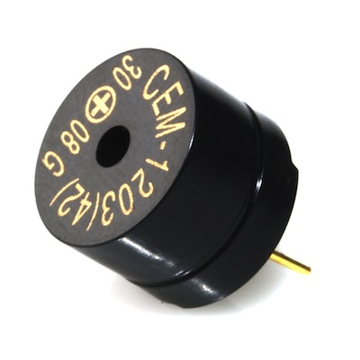
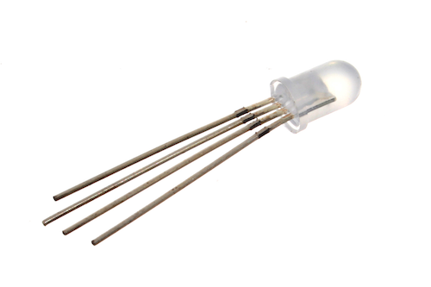
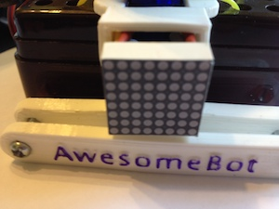
Actuators in our kits: Light a Sound
 | PIEZO ELEMENT A pulse of current will cause it to click. A stream of pulses will cause it to emit a tone.
 | LED & RGB LED We are using Common Cathode RGB LEDs. The longer lead is the common lead which connects to ground. The three other leads are for Red, Green and Blue signal
 | LED Matrix 8 x 8 matrix of single colour LEDs. One row 8 pins corresponds to rows and the other to columns. We will connect to these pins via shift registers.

Slide 23
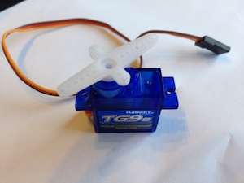
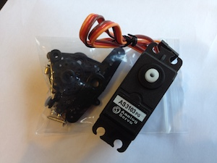
Actuators in our kit: Motors
 | 9g Hobby Servo A box containing a motor with gears to make it positionable from 0 to 180 degrees. Positioning is controlled through a timed pulse, between 1.25 milliseconds (0 degrees) and 1.75 milliseconds (180 degrees) (1.5 milliseconds for 90 degrees).
 | Continuous Rotation Servo A servo that rotates 360 degrees

Slide 24
Digital vs Analog
Digital
  discrete values (0 or 1)
  Examples: tilt sensor, push button
Analog
  continuous values
  typically values for analog sensors are constrained within a range e.g. 0 – 255, 0 – 1023
  Example: photo resistor
Some sensors and actuators support both digital and analog modes

Slide 25
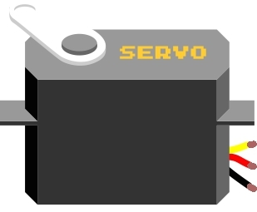
Connecting a servo
Connect the red lead to power
Connect the brown (sometimes black) lead to ground
Connect the orange (sometimes yellow) signal lead to one of the I/O pins on the Arduino that supports Pulse Width
Modulation (PWM):
3, 5, 6, 9, 10, 11

Slide 26
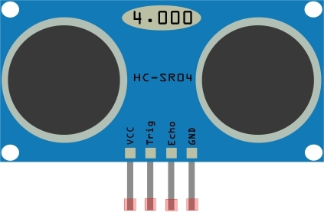
Connecting a sensor
Connect VCC to power
Connect GND to ground
Connect the other pin(s) to I/O pins on the Arduino

Slide 27
Credits
Some of the images in these slides were taken from the Arduino Experimenters Guide created by .:oomlout:. and SparkFun and are used under a CC-BY-SA license.
See http://node-ardx.org for more details

